Slide 1

Decision Trees
Chapter 08 (part 01)

Slide 2
Outline
The Basics of Decision Trees
Regression Trees
Classification Trees
Pruning Trees
Trees vs. Linear Models
Advantages and Disadvantages of Trees

Slide 3
Partitioning Up the Predictor Space
One way to make predictions in a regression problem is to divide the predictor space (i.e. all the possible values for for X₁,X₂,…,X_{p}) into distinct regions, say R₁, R₂,…,R_{k}
Then for every X that falls in a particular region (say R_{j}) we make the same prediction,

Slide 4
Regression Trees
Suppose for example we have two regions R₁ and R₂ with
Then for any value of X such that we would predict 10, otherwise if we would predict 20.

Slide 5
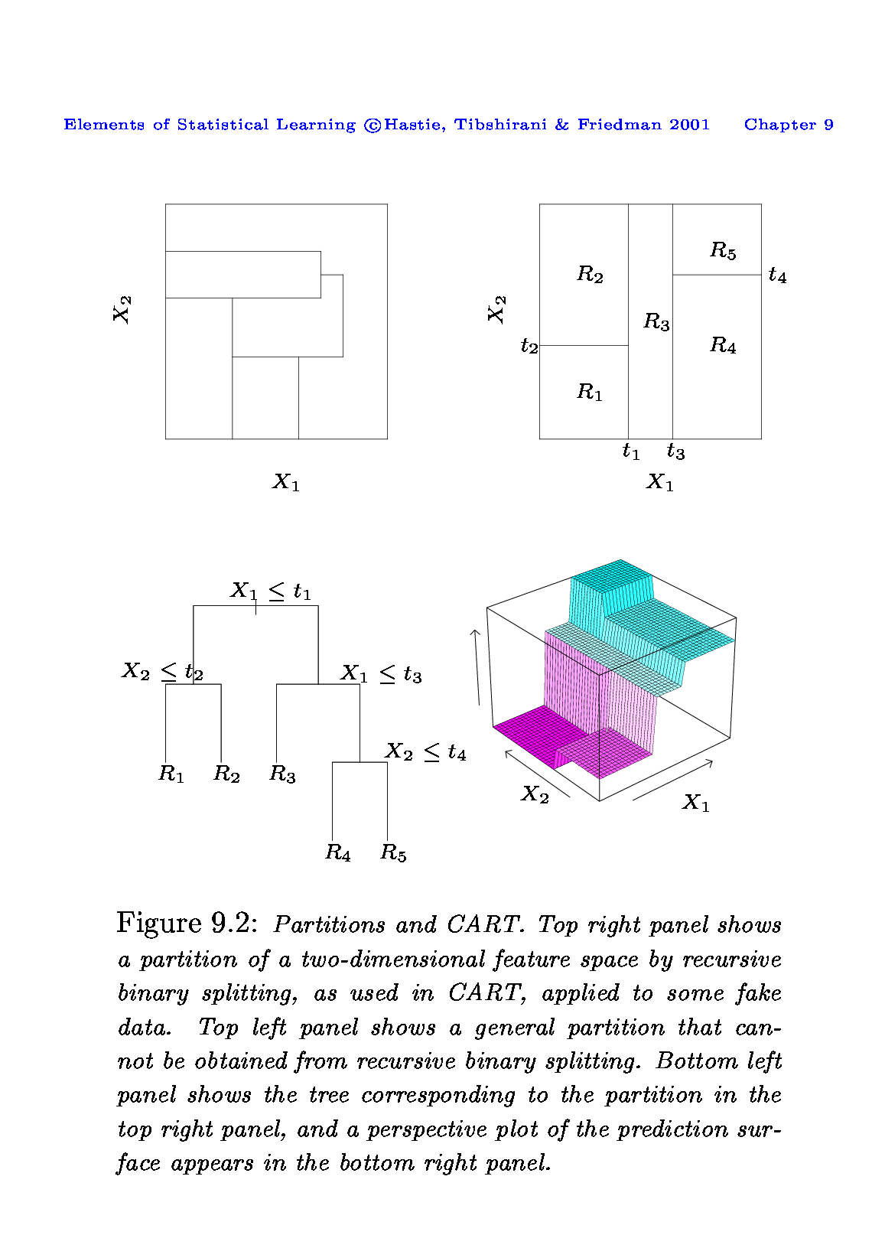
The General View
Here we have two predictors and five distinct regions
Depending on which region our new X comes from we would make one of five possible predictions for Y.
22
12
9
34
23

Slide 6
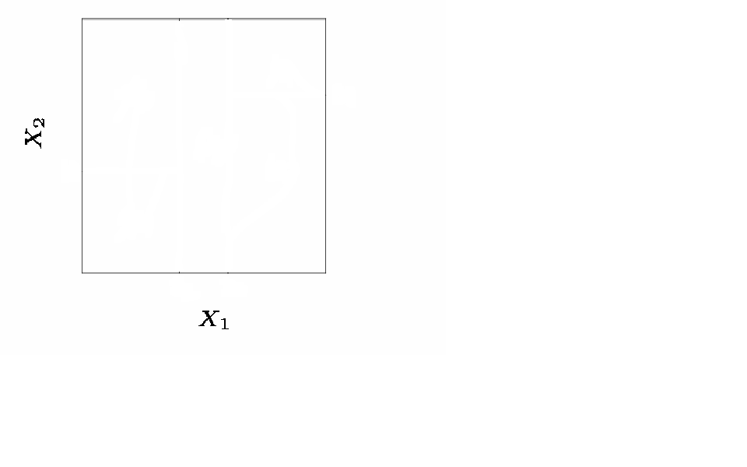
Splitting the X Variables
Generally we create the partitions by iteratively splitting one of the X variables into two regions

Slide 7
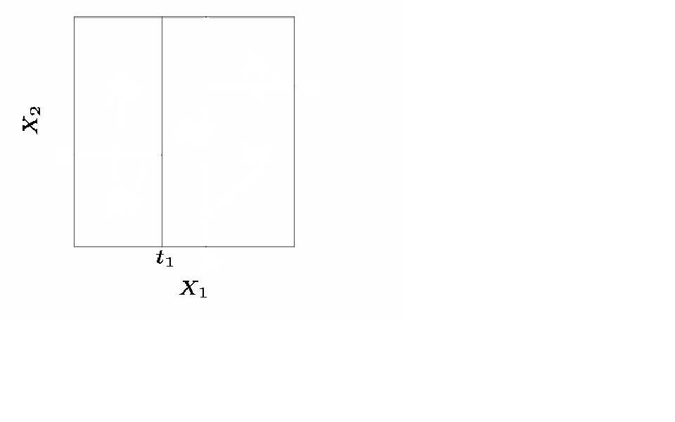
Splitting the X Variable
First split on X₁=t₁

Slide 8
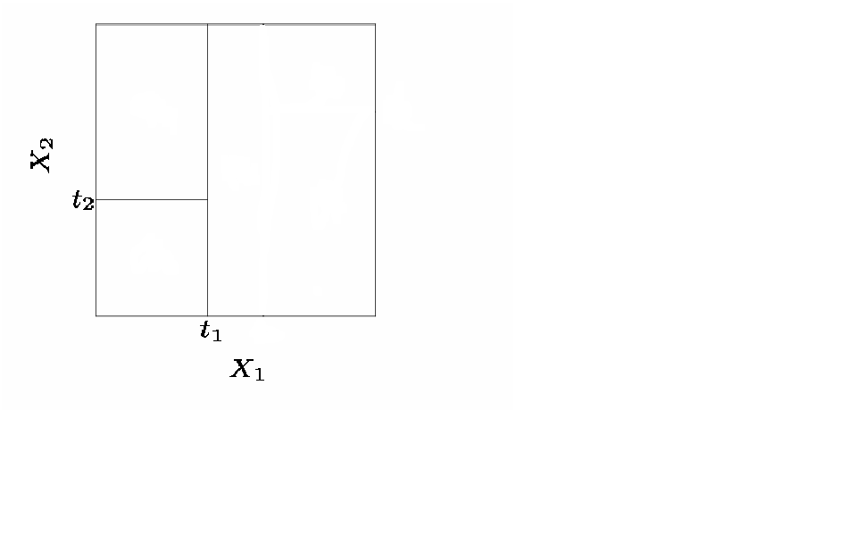
Splitting the X Variable
First split on X₁=t₁
If X₁<t₁, split on X₂=t₂

Slide 9
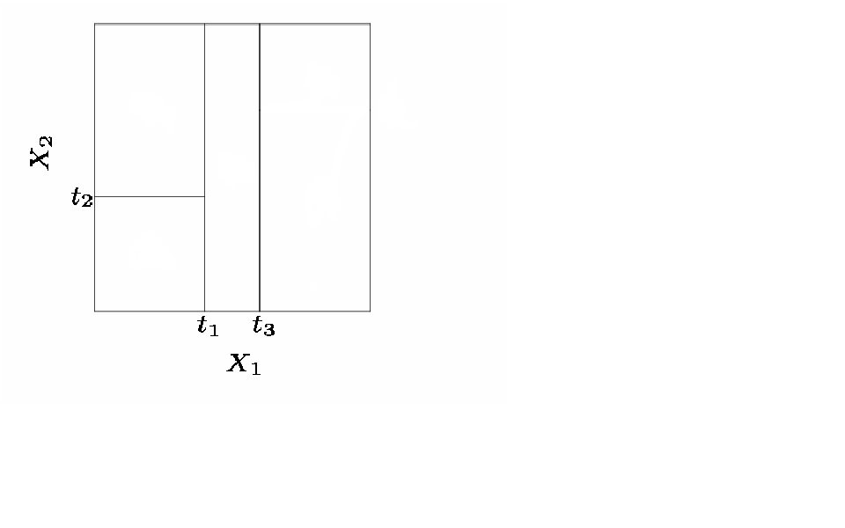
Splitting the X Variable
First split on X₁=t₁
If X₁<t₁, split on X₂=t₂
If X₁>t₁, split on X₁=t₃

Slide 10
Splitting the X Variable
First split on X₁=t₁
If X₁<t₁, split on X₂=t₂
If X₁>t₁, split on X₁=t₃
If X₁>t₃, split on X₂=t₄

Slide 11
Splitting the X Variable
When we create partitions this way we can always represent them using a tree structure.
This provides a very simple way to explain the model to a non-expert i.e. your boss!

Slide 12
Example: Baseball Players’ Salaries
The predicted Salary is the number in each leaf node. It is the mean of the response for the observations that fall there
Note that Salary is measured in 1000s, and log-transformed
The predicted salary for a player who played in the league for more than 4.5 years and had less than 117.5 hits last year is

Slide 13
Another way of visualizing the decision tree…

Slide 14
Some Natural Questions
Where to split? i.e. how do we decide on what regions to use i.e. R₁, R₂,…,R_{k} or equivalently what tree structure should we use?
What values should we use for ?

Slide 15
What values should we use for ?
Simple!
For region R_{j}, the best prediction is simply the average of all the responses from our training data that fell in region R_{j}.

Slide 16
1. Where to Split?
We consider splitting into two regions, X_{j}>s and X_{j}<s for all possible values of s and j.
We then choose the s and j that results in the lowest MSE on the training data.

Slide 17
Where to Split?
Here the optimal split was on X₁ at point t₁.
Now we repeat the process looking for the next best split except that we must also consider whether to split the first region or the second region up.
Again the criteria is smallest MSE.

Slide 18
Where to Split?
Here the optimal split was the left region on X₂ at point t₂.
This process continues until our regions have too few observations to continue e.g. all regions have 5 or fewer points.

Slide 19
Growing a Classification Tree
A classification tree is very similar to a regression tree except that we try to make a prediction for a categorical rather than continuous Y.
For each region (or node) we predict the most common category among the training data within that region.
The tree is grown (i.e. the splits are chosen) in exactly the same way as with a regression tree except that minimizing MSE no longer makes sense.
There are several possible different criteria to use such as the “gini index” and “cross-entropy” but the easiest one to think about is to minimize the error rate.

Slide 20
Example: Orange Juice Preference
Training Error Rate = 14.75%
Test Error Rate = 23.6%

Slide 21
Improving Tree Accuracy
A large tree (i.e. one with many terminal nodes) may tend to over fit the training data in a similar way to neural networks without a weight decay.
Generally, we can improve accuracy by “pruning” the tree i.e. cutting off some of the terminal nodes.
How do we know how far back to prune the tree? We use cross validation to see which tree has the lowest error rate.

Slide 22
Example: Baseball Players’ Salaries
The minimum cross validation error occurs at a tree size of 3

Slide 23
Example: Baseball Players’ Salaries

Slide 24
Example: Baseball Players’ Salaries
Cross Validation indicated that the minimum MSE is when the tree size is three (i.e. the number of leaf nodes is 3)

Slide 25
Example: Orange Juice Preference
Pruned Tree
CV Tree Error Rate = 22.5%
Full Tree Training Error Rate = 14.75%
Full Tree Test Error Rate = 23.6%

Slide 26
Trees vs. Linear Models
Which model is better?
If the relationship between the predictors and response is linear, then classical linear models such as linear regression would outperform regression trees
On the other hand, if the relationship between the predictors is non-linear, then decision trees would outperform classical approaches

Slide 27
Trees vs. Linear Model: Classification Example
If the true decision boundary is linear
If the true decision boundary is non-linear
linear model (good)
decision tree (good)

Slide 28
Pros and Cons of Decision Trees
Pros:
Trees are very easy to explain to people (probably even easier than linear regression)
Trees can be plotted graphically, and are easily interpreted even by non-expert
They work fine on both classification and regression problems
Cons:
Trees don’t have the same prediction accuracy as some of the more complicated approaches that we examine in this course

